Slide 1
Unearthing the patterns inside CU’s Graduate Admission Process
Santhosh Pattamudu Manoharan
Abiram Vyas
Niranjan Cholendiran
Saaijeesh Sottalu Naresh
Notes:
Hi everyone,
It is with great pleasure that I share our research "unearthing the patterns inside CU's graduate admission process" for the course STAT 5000
Introducing the team : I'm santhosh, blah. So we will move on to the agenda of our presentation.

Slide 2
Agenda
Problem Statement & Research Overview
Dataset Understanding
Exploratory Data Analysis
Trend of applicants
Course popularity at CU
Influence of standardized test scores
Hypothesis Testing
Conclusion
Notes:
This the gist of our presentation
We will start with problem statement and research overview
Followed by the dataset understanding
Performing the EDA to find the trend of applicant
Course popularity at CU
Influence of standardized test scores

Slide 3
Problem Statement and Research Overview
Research Overview
Problem Statement
Analyze application trends and admission ratios to derive insights into the dynamics of master's degree in the United States
Key Questions
Is there a consistent increase in master's degree applicants over time?
What are the predominant master's courses attracting applicants to CU?
Has the significance of standardized test scores in admissions changed post-Covid?
Is there a noticeable difference in admission ratios between resident and non-resident applicants?
Notes:
Our research started with a question,
to derive the insights about the master's degree admission by analyzing the admission data Where we have tried to answer the following key questions like
Is there a consistent increase in master's degree applicants over time?
What are the predominant master's courses attracting applicants in the U.S.?
Has the significance of standardized test scores in admissions changed post-Covid?
Is there a noticeable difference in admission ratios between resident and non-resident applicants?

Slide 4
HOW ?

Slide 5
Problem Statement and Research Overview
Research Overview
Research Overview
Analyze admission data among diverse applicant groups using EDA.
Employ statistical tests to confirm or reject hypotheses, unveiling influential factors in admission rates.
Use trend insights for universities to develop popular courses, aiding students in choosing matching, high-admission-prospect programs.
Notes:
We started by analyzing the admission data using EDA,
With which we framed some of the hypothesis as we saw in our problem statement.
We have used statistical test to test out aswell.
So, this could be very usefull for the universities to provide more indemand courses and helps the student in choosing courses that aligns with their preference which has high demand in the market.

Slide 6
Dataset Understanding

Slide 7
Dataset Understanding
Data Overview
Office of Data Analytics at CU Boulder Tableau Dashboard
Focuses on Master's degree data exclusively, covering from 2011 to 2023
Possible bias due to higher proportion of international applicants
Notes:
We will talk about the dataset -
So we got this data from office of analytics at CU Tableau Dashboard
Since our research focuses on masters data wee have filtered only for masters applicants over the period 2011 to 2023.
Also, there might be an possible bias in our EDA towards international applicants because the ratio of international

Slide 8
Dataset Understanding
Data Overview
Key Columns
Admit_Status - Status of the application
Level – Level of Graduate Study
Residency - Resident of Colorado or not
Bach_GPA - Bachelor's GPA
GRE2011 Quant – GRE Quant Score
GRE2011 Verbal – GRE Verbal Score
Major – Graduate Major

Slide 9
Exploratory Data Analysis

Slide 10
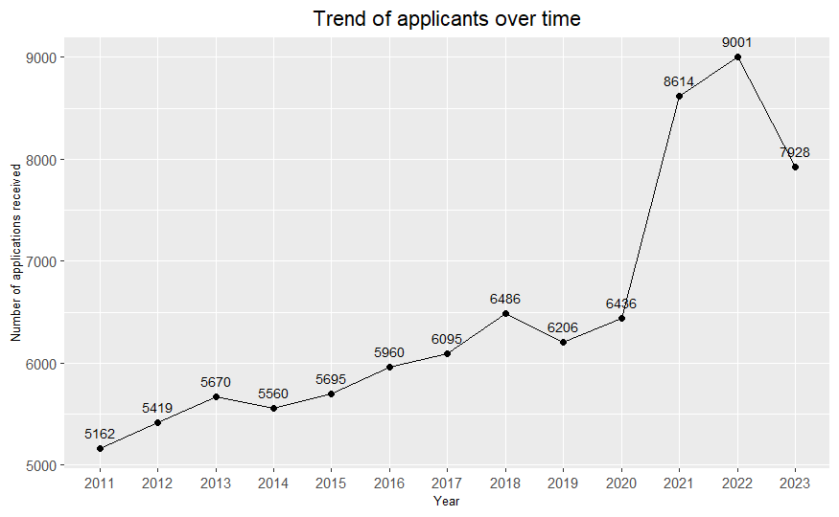
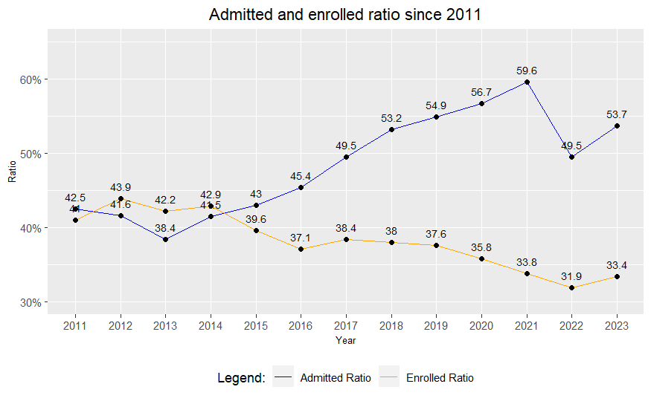
There has been a constant up-trend in the number of applicants over the last 10 years
Trend of Applicants
Findings
Over the last 10 years, there has been a constant increase in the number of applicants at CU Boulder
The admitted and enrolled ratio have contrasting trends. Though the admitted ratio is on the rise, the enrolled ratio is having a negative trend
There has been a dip in the number of applicants in 2023. This could be due to various macroeconomic factors such as recessions, war in Europe , etc.

Slide 11
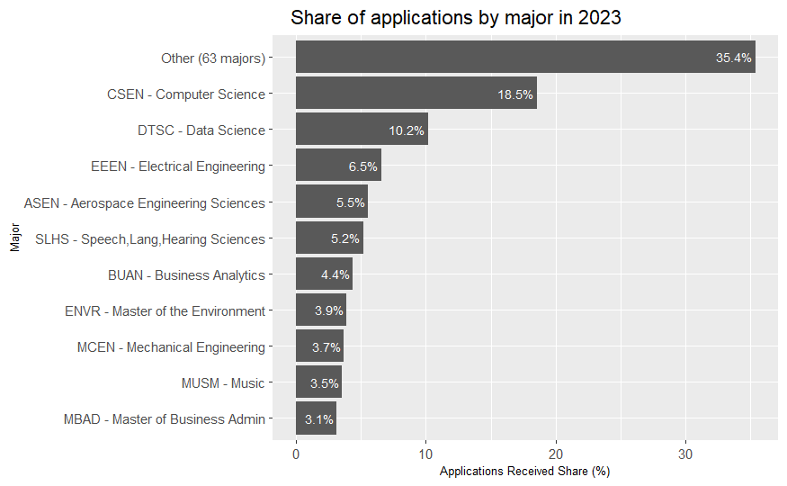
In 2023, Computer Science and Data Science are the most sought after courses
Course Popularity at CU
Findings
Computer Science and Data Science remain the popular courses at CU despite Data Science being launched only in 2021
Out of a total of around 73 majors, 10 majors contribute to around 64% of the applicants, of which, Computer Science, Data Science and Electrical Engineering contributed 35%

Slide 12
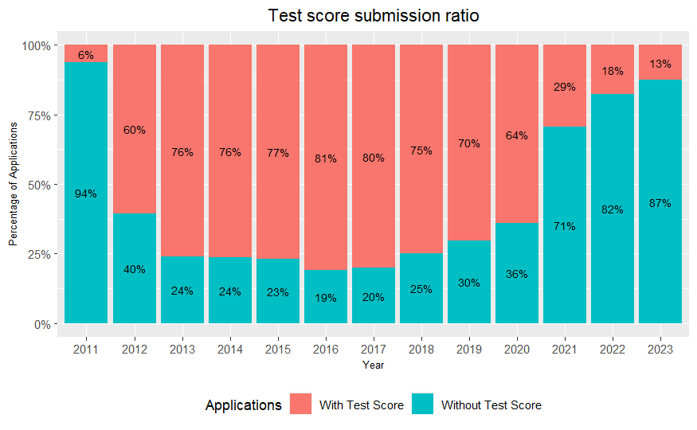
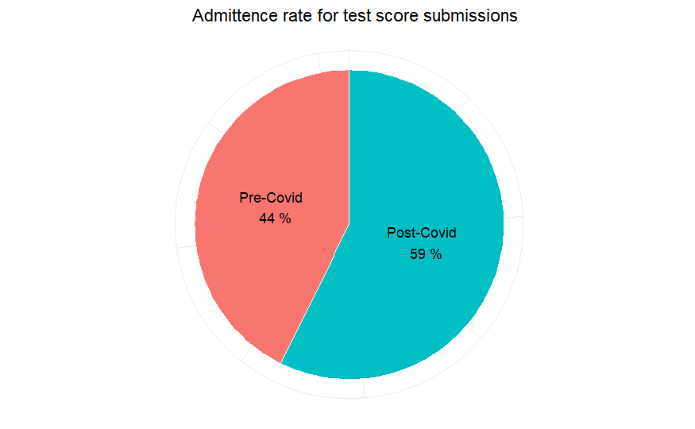
Applicants submitting their standardized scores have a higher chance of obtaining an admit
Influence of test scores
Test scores influence admission decision post-covid only in CU Boulder?
Findings
Proportion of applicants with standardized scores remained around the 70% mark until 2020 post which it has reduced drastically to be almost closer to 15%
Applicants who chose to submit a standardized test score witnessed a higher acceptance ratio. It can be derived that students currently prefer not to submit their standardized test scores
Notes:
Next EDA, we have is regarding the influence of standardized test scores on admittance ratio.
Those test socres are either GRE/ GMAT
The first chart indicates the ratio of applicants who submitted and not submitted standardizes test scores along with their application
If you look at the trend, until 2020 almost 70% of of the applicants submitted their test scores, but after 2020 the number went down drastically to just 13% in 2023.
Why did this happen?
Mainly because CU and most universities in the U.S. made test scores optional.
Now the question is, did test scores influence the admission result post covid?
Look at the second graph which is the admittance rate of of those applications that were submitted with test scores. Surprisingly, post covid- 58% of applications that were received with test scores were admitted but the ratio was only 44%.
That indicates Test Scores still have an influence- atleast in CU boulder.

Slide 13

Applicants submitting their standardized scores have a higher chance of obtaining an admit
Influence of test scores
Test scores influence admission decision post-covid only in CU Boulder?
Findings
Proportion of applicants with standardized scores remained around the 70% mark until 2020 post which it has reduced drastically to be almost closer to 15%
Applicants who chose to submit a standardized test score witnessed a higher acceptance ratio. It can be derived that students currently prefer not to submit their standardized test scores
Notes:
Next comes the big question: Is this trend of test scores having higher impact post covid only in CU Boulder? Or is common in the entire United States?

Slide 14


Hypothesis Testing
Notes:
Let’s check that through a two-sample hypothesis test.

Slide 15
Ratio of applicants admitted with test scores has increased nationwide post-covid
Hypothesis 1
Population
Image Source: www.businessinsider.com
Notes:
The hypothesis we have is that “Ratio of applicants admitted with test scores has increased nationwide post-covid”
Population we are going to estimate: Entire U.S. data

Slide 16



Ratio of applicants admitted with test scores has increased nationwide post-covid
Hypothesis 1
Sample
Pre-Covid
Post-Covid
Applied ($n_{1}$): 35,459
Admitted: 15,431
Ratio ($\hat{p_{1}}$): 0.44
Applied ($n_{2}$): 5,126
Admitted: 3,044
Ratio ($\hat{p_{2}}$): 0.59
$$H_{O}:P_{1}≥P2 \\ :P_{1}−P_{2}≥0$$
$$H_{A}:P_{1}<P2 \\ :P_{1}−P_{2}<0$$
$$P_{1}:Admit ratio pre−covid$$
$$P_{2}:Admit ratio post−covid$$
Notes:
Samples we have is CU boulder admission data pre and post covid.
They have proportions 0.44 and 0.59 as we saw in the previous slides. Both have a huge sample sizes, 35k and 5k records, so it is safe to assume that sample proportions will follow normal distribution (according to CLT).

Slide 17
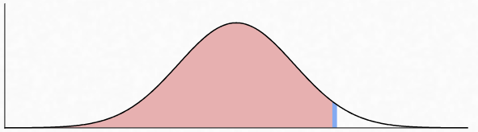
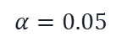


Ratio of applicants admitted with test scores has increased nationwide post-covid
Hypothesis 1
$$H_{O}:P_{1}≥P2 \\ :P_{1}−P_{2}≥0$$
$$H_{A}:P_{1}<P2 \\ :P_{1}−P_{2}<0$$
$$P_{1}:Admit ratio pre−covid$$
$$P_{2}:Admit ratio post−covid$$
$$α=0.05$$
Pre-Covid
Post-Covid
Applied ($n_{1}$): 35,459
Admitted: 15,431
Ratio ($\hat{p_{1}}$): 0.44
Applied ($n_{2}$): 5,126
Admitted: 3,044
Ratio ($\hat{p_{2}}$): 0.59
-0.15
-0.146
0
Difference of sample proportions ($\hat{p_{1}} −\hat{p_{2}}$)
$$Reject H_{O}$$
Notes:
The null hypothesis in this case is population proportions P1 >= P2 and alternate is P1< P2.

Slide 18

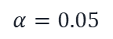
Ratio of applicants admitted with test scores has increased nationwide post-covid
Hypothesis 1
Admittance ratio has increased for those who submit test scores post-covid nationwide
$$H_{O}:P_{1}≥P2 \\ :P_{1}−P_{2}≥0$$
$$H_{A}:P_{1}<P2 \\ :P_{1}−P_{2}<0$$
$$P_{1}:Admit ratio pre−covid$$
$$P_{2}:Admit ratio post−covid$$
$$α=0.05$$
Post-COVID, universities made test scores optional but show a preference for applicants who choose to submit them?
-0.15
-0.146
0
Difference of sample proportions ($\hat{p_{1}} −\hat{p_{2}}$)
$$Reject H_{O}$$
Notes:
By setting the level of significance as 0.5%, we get a confidence interval for the difference in sample proportions as less than -0.14. So, it is very rare (let’s say less than 5% chance) that the difference in population proportions be zero.
So, we can reject the null hypothesis.

Slide 19

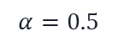
Ratio of applicants admitted with test scores has increased nationwide post-covid
Hypothesis 1
Admittance ratio has increased for those who submit test scores post-covid nationwide
$$H_{O}:P_{1}≥P2 \\ :P_{1}−P_{2}≥0$$
$$H_{A}:P_{1}<P2 \\ :P_{1}−P_{2}<0$$
$$P_{1}:Admit ratio pre−covid$$
$$P_{2}:Admit ratio post−covid$$
$$α=0.5$$
Post-COVID, universities made test scores optional but show a preference for applicants who choose to submit them?
-0.15
-0.146
0
Difference of sample proportions ($\hat{p_{1}} −\hat{p_{2}}$)
$$Reject H_{O}$$
Notes:
This shows the admittance ratio has increased for those who submit test scores post-covid.
But can we conclude that post-COVID, universities made test scores optional but show a preference for applicants who choose to submit them?
- Not really, though it looks like that from the data presented, it might be just the overall profile of applicants who voluntarily submitted though it wasn’t mandatory, might have had a beter profile overall (like better SOP, LOR, Resume, or GPA).
- So, we can conclude that test scores still have an influence but it is not the only decider.
That’s the end of this hypothesis test, we also found an other interesting insight that’ll be covered by Saaijeesh and he’ll wrap up the presentation.

Slide 20
Admittance ratio of residents vs non-residents?
Influence of residency status
Non-residents might be preferred more due to:
High tuition fee
Increase diversity
Enhance reputation and global scale ranking
and more…
75%
Residents are accepted more only in CU Boulder?
45%
Findings
Since, 2011, on an average 45% of the non-residence were admitted, however the number is drastically high as 75% for residence.
Hence, in CU boulder it is not the trend to accept more non-residence, but it’s the opposite.
Notes:
The next analysis is similar to the previous ones, but here we are going to compare the admittance ratio of residence vs non-residence.
There’s a very common belief that, master admittance ratio for non-residence will be high due to various reasons,
Non-residence often pay high tution fee than residence.
To increase diversity
Enhance the reputation and ranking on a global scale.
And more
But CU Boulder’s admission data (on the right) indicates the opposite: 1. Since, 2011, on an average 45% of the non-residence were admitted, however the number is drastically high upto 75% for residence.
Hence, in CU boulder it is not the trend to accept more non-residence, but it’s the opposite

Slide 21
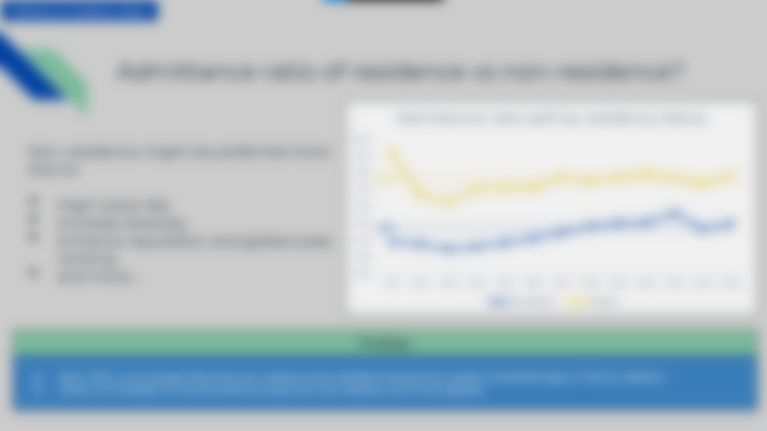
Admittance ratio of residents vs non-residents?
Influence of residency status
Non-residents might be preferred more due to:
High tution fee
Increase diversity
Enhance reputation and global scale ranking
and more…
Residents are accepted more only in CU Boulder?
75%
45%
Findings
Since, 2011, on an average 45% of the non-residence were admitted, however the number is drastically high as 75% for residence.
Hence, in CU boulder it is not the trend to accept more non-residence, but it’s the opposite.
Population
Notes:
But can we conclude that this trend is only applicable in CU Boulder? Or the entire United States?
- Let’s find out using a 2 sample hypothesis test.

Slide 22
Residents are accepted more in the U.S. universities more than non-residents
Hypothesis 2
Population
Image Source: www.businessinsider.com
Notes:
So, the hypothesis is “Residents are accepted more in the U.S. universities more than non-residents”
Similar to previous test the population we are going to estimate is the entire U.S. admission

Slide 23



Residents are accepted more in the U.S. universities more than non-residents
Hypothesis 2
Sample
Residents
Non-Residents
Applied ($n_{1}$): 13,016
Admitted: 9,776
Ratio ($\hat{p_{1}}$): 0.75
Applied ($n_{2}$): 69,834
Admitted: 31,440
Ratio ($\hat{p_{2}}$): 0.45
$$H_{O}:P_{1}≤P2 \\ :P_{1}−P_{2}≤0$$
$$H_{A}:P_{1}>P2 \\ :P_{1}−P_{2}>0$$
$$P_{1}:Resident^{′}s admit ratio$$
$${ P}_{2}:Non−Resident^{′}s admit ratio$$
Notes:
and the sample we have is CU Boulder’s admission.
Where the proportion of resident’s admission is 75% and non-resident’s is 45% as we saw in the previous slide.
Both have a huge sample sizes of 13k and 69k records, so it is safe to assume that sample proportions will follow normal distribution (according to CLT).

Slide 24
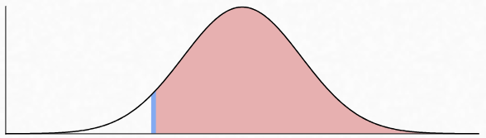
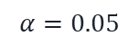

Residents are accepted more in the U.S. universities more than non-residents
Hypothesis 2
$$H_{O}:P_{1}≤P2 \\ :P_{1}−P_{2}≤0$$
$$H_{A}:P_{1}>P2 \\ :P_{1}−P_{2}>0$$
$$P_{1}:Resident^{′}s admit ratio$$
$${ P}_{2}:Non−Resident^{′}s admit ratio$$
$$α=0.05$$
Residents
Non-Residents
Applied ($n_{1}$): 13,016
Admitted: 9,776
Ratio ($\hat{p_{1}}$): 0.75
Applied ($n_{2}$): 69,834
Admitted: 31,440
Ratio ($\hat{p_{2}}$): 0.45
0
0.293
0.35
Difference of sample proportions ($\hat{p_{1}} −\hat{p_{2}}$)
$$Reject H_{O}$$
Notes:
The null hypothesis in this case is population proportions P1 <= P2 and alternate is P1> P2.

Slide 25

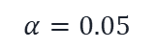
Residents are accepted more in the U.S. universities more than non-residents
Hypothesis 2
Admittance ratio is higher for residents than non-residents
$$H_{O}:P_{1}≤P2 \\ :P_{1}−P_{2}≤0$$
$$H_{A}:P_{1}>P2 \\ :P_{1}−P_{2}>0$$
$$P_{1}:Resident^{′}s admit ratio$$
$${ P}_{2}:Non−Resident^{′}s admit ratio$$
$$α=0.05$$
Hence, our assumption that non-residents getting more admission due to the factors we discussed is not true
0
0.293
0.35
Difference of sample proportions ($\hat{p_{1}} −\hat{p_{2}}$)
$$Reject H_{O}$$
Notes:
By setting the level of significance as 5%, we get a confidence interval for the difference in sample proportions as greater than 0.29. So, it is very rare (let’s say less than 5% chance) that the difference in population proportions be zero.
So, we can reject the null hypothesis.

Slide 26

Residents are accepted more in the U.S. universities more than non-residents
Hypothesis 2
Admittance ratio is higher for residents than non-residents
$$H_{O}:P_{1}≤P2 \\ :P_{1}−P_{2}≤0$$
$$H_{A}:P_{1}>P2 \\ :P_{1}−P_{2}>0$$
$$P_{1}:Resident^{′}s admit ratio$$
$${ P}_{2}:Non−Resident^{′}s admit ratio$$
$$α=0.5$$
Hence, our assumption that non-residents getting more admission due to the factors we discussed is not true
0
0.293
0.35
Difference of sample proportions ($\hat{p_{1}} −\hat{p_{2}}$)
$$Reject H_{O}$$
Notes:
This shows the admittance ratio is higher for residence than non-residence in the U.S..
So, our common assumption that non-residence getting more admission due to the factors we discussed is not true.

Slide 27
Conclusion
Notes:
Now, we have come to the conclusion of the presentation and these are the main take aways from our analysis:

Slide 28
Key takeaways
Hypothesis 2
The trend of master's applicants has increased by 53% in 2023 from 2011.
CSEN, DTSC, EEEN and ASEN are the popular master’s courses at CU.
Standardized test scores have an influence in the admission post-covid not just in CU but the entire U.S.
Admittance ratio of residents are more than non-residents not just in CU but the entire U.S.
Notes:
1. The trend of masters applicants has increased by 53% in 2023 from 2011.
2. CS, DS ECE and AER are the popular courses at CU
3. Standardized test scores have an influence in the admission post-covid not just in CU but the entire U.S.
4. Admittance ratio of residents are more than non-residents not just in CU but the entire U.S.

